Slide 1



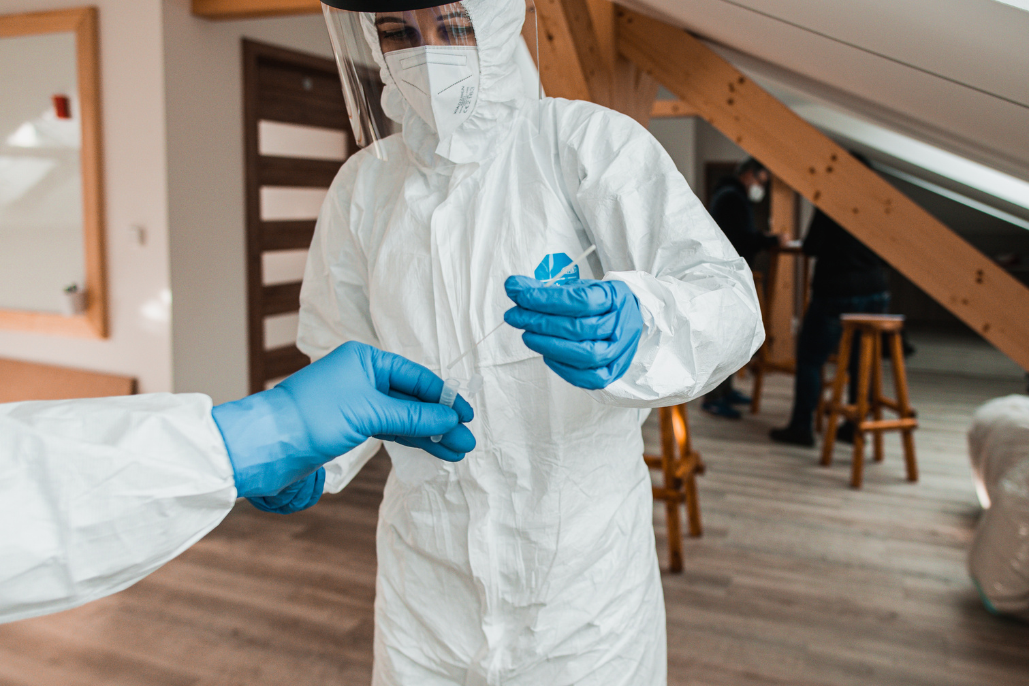
Laboratory-Based Detection of Human Brucellosis in a Private Level 2 Health Facility in Nakuru County, Kenya: Identifying Gaps in One Health Surveillance and Health Security
Medical Laboratory Technologist| Lucymaina545@gmail.com
Lucy Wanjiku Maina
One Health Approach
Kenya Health Security Convention | 5th – 8th May 2026 | Mombasa - Kenya

Slide 2
Background
1.6-2.1B
82.3%
57.5%
100K+
Annual cases globally (Barakat, 2025).
Countries at risk (Laine et al., 2023).
African population at risk (Laine et al., 2023).
Cases annually in Kenya (Evans, 2025).
Key Risk Factors
70-75% of Human cases: caused by B.abortus & B.melitensis (Barakat, 2025)
High-Risk Groups
Unpasteurized dairy products
Livestock contact & handling
Occupational exposure
Healthcare professionals
Veterinarians
Animal breeders

Slide 3
Problem Statement & Justification
①
②
③
Underdiagnosis
Testing Limitations
Surveillance Gap
Only ½ million cases registered annually vs. WHO estimates of higher true incidence (Ghanbari et al., 2020).
Slide Agglutination Test (BAT): Rapid but cannot confirm active infection
Private facilities detect cases but lack linkage to national surveillance systems

Slide 4
Objectives
Assess BAT testing pattern & volume (Private Level 2 health facility).
Determine Seroreactivity by Age & Gender
Identify Gaps in One Health surveillance integration

Slide 5
Methodology
Setting
Design
Private Level II, Salgaa, Nakuru County
Retrospective lab data review: facility-based data
Period
Tests
October 2024 - September 2025
B. abortus & B. melitensis (BAT) (using Slide Agglutination Testing approach).
✓ Quality Control: All BAT reagent lots verified with QC procedures prior to use | Operator training completed | Ethics approval obtained

Slide 6
Results: Testing Distribution & Seroreactivity
Testing by Age Group & Gender
Seroreactivity Rate
Highest testing and seroreactivity among females: 41.4% vs 33% (males).
Highest testing & seroreactivity: 20-39 years
Seroreactivity across all age groups
Notable peaks: 20-39 & 40-59 years
38.2%
Evidence of exposure across the population

Slide 9
Discussion
Epidemiological Signal
High seroreactivity (38.2%) indicates significant exposure in the population.
Screening Value
BAT is valuable in low-resource settings despite limited specificity.
Critical Gap
Detected/suspected cases are not reported to public health or veterinary systems.
Missing Data
Absence of linked clinical data reveals weak integrated surveillance, especially in private sector.

Slide 10
Policy Impact & Implications
Diagnostic & surveillance gaps prevent systematic capture of epidemiological signals in surveillance systems
Brucellosis is being detected at primary care level—these represent early warning signals
Strategic Recommendations
Mandatory reporting of reactive cases from private facilities to Sub-county Health Offices (weekly/monthly).
1
Establish formal linkages: Implement MoUs between private, public, and veterinary services.
2
Implement tiered confirmation: Maintain BAT as screening tool; refer reactive samples to higher-level labs for confirmation.
3
Institutionalize quarterly One Health coordination meetings between all sectors.

Slide 11
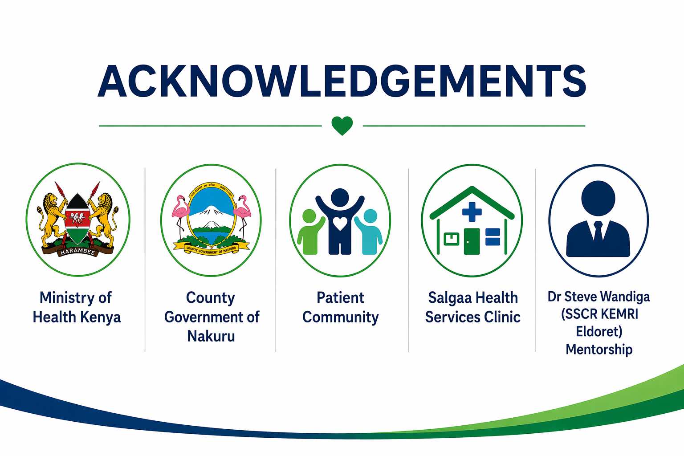

Slide 12






Thank you!
Scan to visit our website
#KeHSCon2026
@NPHIKenya
www.nphi.go.ke

